Slide 1
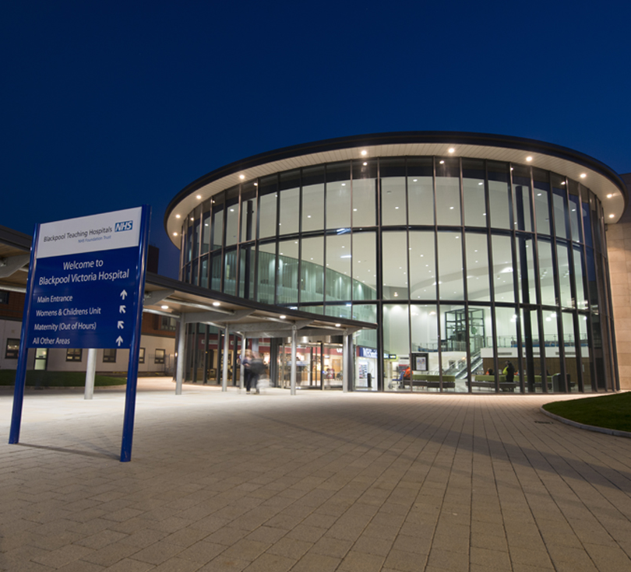
OPTIMA TRIAL: Challenges and opportunities
BLACKPOOL VICTORIA HOSPITAL
Pavel Bezecny, Adrian McKenna
OPTIMA Investigators Meeting 22/05/2024

Slide 2
BLACKPOOL BREAST UNIT
300-350 breast cancer cases per annum
80-90 cases for (neo)adjuvant chemotherapy
4 surgeons
2 oncologists (1 medical, 1 clinical)
4 BCNs

Slide 3
BLACKPOOL BREAST CANCER RESEARCH
8 breast cancer trials currently open to recruitment
4 oncology research nurses

Slide 4
BLACKPOOL BREAST CANCER RESEARCH
8 breast cancer trials currently open to recruitment
Early BC: OPTIMA, POETIC A, ASTEFANIA
4 oncology research nurses

Slide 5
BLACKPOOL BREAST CANCER RESEARCH
8 breast cancer trials currently open to recruitment
Early BC: OPTIMA, POETIC A, ASTEFANIA
Advanced BC: SERENA 6, INAVO 121, INAVO 122,
heredERA, KEYNOTE-B49
4 oncology research nurses

Slide 6
BLACKPOOL STRENGTHS:

Slide 7
BLACKPOOL STRENGTHS: suitable recruits don’t get missed

Slide 8
BLACKPOOL STRENGTHS: suitable recruits don’t get missed trial introduced by right person at right time

Slide 9
BLACKPOOL STRENGTHS: suitable recruits don’t get missed

Slide 10
BLACKPOOL STRENGTHS: suitable recruits don’t get missed
Pro-active identification of potential trial recruits
At MDT
Screening of potential candidates by research nurses

Slide 11
BLACKPOOL STRENGTHS: suitable recruits don’t get missed
Pro-active identification of potential trial recruits
At MDT
Screening of potential candidates by research nurses
MDT engagement - Surgery/oncology/pathology/radiology/BCNs/research nurses
Trial education/awareness
Non-reliance on individuals

Slide 12
BLACKPOOL STRENGTHS: suitable recruits don’t get missed
Pro-active identification of potential trial recruits
At MDT
Screening of potential candidates by research nurses
MDT engagement - Surgery/oncology/pathology/radiology/BCNs/research nurses
Trial education/awareness
Non-reliance on individuals
MDT documentation – references potential research trials as well as patient treatment plans

Slide 13
BLACKPOOL STRENGTHS: trial introduced by right person at right time

Slide 14
BLACKPOOL STRENGTHS: trial introduced by right person at right time
Specialist nurse involvement
Breast Care Nurse involvement

Slide 15
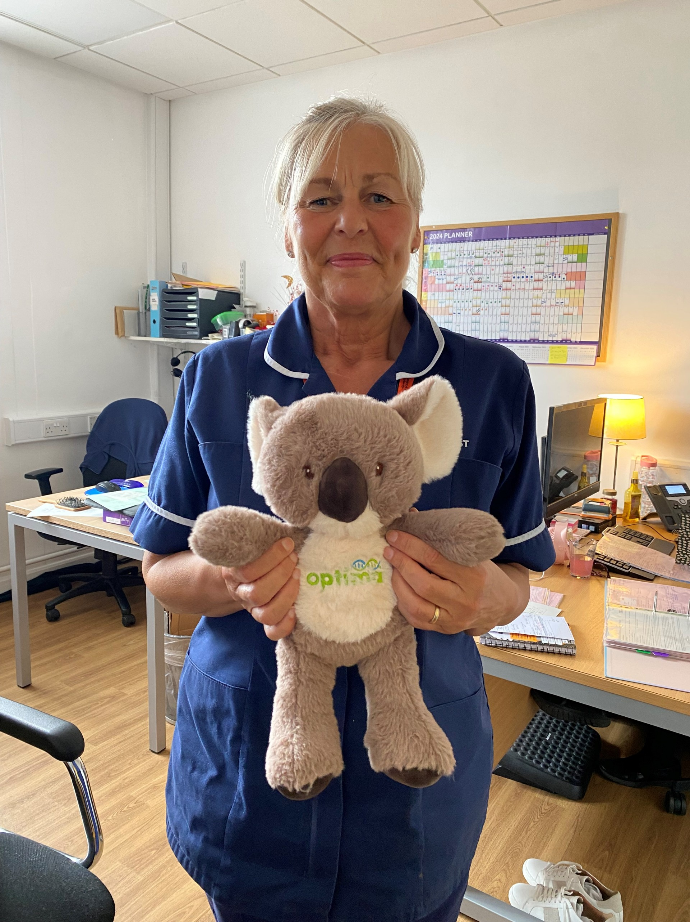
Breast Care Nurses:
Sarah Wilkinson
Hayley Podesta
Louise Carter
Lynette Bracegirdle

Slide 16
BLACKPOOL STRENGTHS: trial introduced by right person at right time
Specialist nurse involvement
BCN involvement
Trial introduction/advocation – early in treatment

Slide 17
BLACKPOOL STRENGTHS: trial introduced by right person at right time
Specialist nurse involvement
BCN involvement
Trial introduction/advocation – early in treatment
Nurse teamwork/co-operation – BCN/Oncology nurses/research nurses

Slide 18
BLACKPOOL STRENGTHS: trial introduced by right person at right time
Specialist nurse involvement
BCN involvement
Trial introduction/advocation – early in treatment
Nurse teamwork/co-operation – BCN/Oncology nurses/research nurses
Surgeon
Oncologist
Leadership from PI

Slide 19
BLACKPOOL STRENGTHS: trial introduced by right person at right time
Specialist nurse involvement
BCN involvement
Trial introduction/advocation – early in treatment
Nurse teamwork/co-operation – BCN/Oncology nurses/research nurses
Surgeon
Oncologist
Leadership from PI
Early adopter OPTIMA trial

Slide 20
CHALLENGES

Slide 21
CHALLENGES
Staffing challenges/staff turnover (trial awareness)

Slide 22
CHALLENGES
Staffing challenges/staff turnover (trial awareness)
Time (Service) pressures (delays in start of chemotherapy? staff shortages?)

Slide 23
CHALLENGES
Staffing challenges/staff turnover (trial awareness)
Time (Service) pressures (delays in start of chemotherapy?, staff shortages?)
COVID pandemic

Slide 24
CHALLENGES
Staffing challenges/staff turnover (trial awareness)
Time (Service) pressures (delays in start of chemotherapy?, staff shortages?)
COVID pandemic
“Trial fatigue” (long recruitment window)

Slide 25
Blackpool recruitment 2017-2023

Slide 26
Blackpool recruitment 2017-2023

Slide 27
CONCLUSION
Keys to successful recruitment

Slide 28
CONCLUSION
Keys to successful recruitment
Proactive identification (don’t miss suitable recruits)
Early trial introduction (right person, right time)
Multi-professional staff engagement
Specialist Nurse participation and co-operation - breast care, research, chemotherapy (Key!!!)
Trial awareness

Slide 29
CONCLUSION
Keys to successful recruitment
Proactive identification (don’t miss suitable recruits)
Early trial introduction (right person, right time)
Multi-professional staff engagement
Specialist Nurse participation and co-operation - breast care, research, chemotherapy (Key!!!)
Trial awareness
OPTIMA – “easy sell”

Slide 30
OPTIMA TRIAL: Challenges and opportunities
BLACKPOOL VICTORIA HOSPITAL
Pavel Bezecny, Adrian McKenna
OPTIMA Investigators Meeting 22/05/2024

